Slide 1


Noida Institute of Engineering and Technology, Greater Noida
Introduction
Unit: I
Subject Name: Design Thinking II
Course Details: B Tech 5th Sem

Slide 2
Faculty Profile
Experience | Details
Total Experience | 4 Yrs
Teaching Experience | 4th January 2021 to till now Subject Taught/Lab: M.Tech AI Lab in Python, Design Thinking, OOT using JAVA, Artificial Intelligence and Web Technology Subject Interest: Artificial Intelligence, Python
Industrial Work Experience | 2.6 Years Worked as Configuration Management Engineer and Network Integration Engineer in 3G and 4G Technology at Nokia, Sector-62, Noida (21 Jan 2016 to 20 July 2017) Worked as Fault Management Engineer in Ericsson, Sector-62,Noida(2 Feb 2015 to 20 Jan 2016)

Slide 3
Faculty Profile: Coursera Achievements
Education Background | Details
M.Tech in Computer Science Engineering(2017-19) | Gautam Buddha University, Greater Noida
B.Tech in Computer Science Engineering(2011-15) | I.T.S Engineering College, Greater Noida

Slide 4
Faculty Profile: Coursera Achievements
IBM Cybersecurity Analyst certified on Jun 10,2022
Introduction to Cybersecurity Tools & Cyber Attacks Cybersecurity Roles, Processes & Operating System Security Cybersecurity Compliance Framework & System Administration Network Security & Database Vulnerabilities
Penetration Testing, Incident Response and Forensics Cyber Threat Intelligence
Cybersecurity Capstone: Breach Response Case Studies IBM Cybersecurity Analyst Assessment
IBM AI Engineering certified on May 23, 2022
Machine Learning with Python
Introduction to Deep Learning & Neural Networks with Keras Introduction to Computer Vision and Image Processing Deep Neural Networks with PyTorch
Building Deep Learning Models with TensorFlow AI Capstone Project with Deep Learning

Slide 5
Faculty Profile: Coursera Achievements
IBM Applied AI certified on May 19, 2022
Introduction to Artificial Intelligence (AI)
Getting Started with AI using IBM Watson
Building AI Powered Chatbots Without Programming
Python for Data Science, AI & Development
Python Project for AI & Application Development
Building AI Applications with Watson APIs
Programming with Google Go certified on May 12, 2022
Getting Started with Go
Functions, Methods, and Interfaces in Go
Concurrency in Go

Slide 6
Faculty Profile: Coursera Achievements
IBM Data Science certified on Apr 28, 2022
What is Data Science?
Tools for Data Science
Data Science Methodology
Python for Data Science, AI & Development
Python Project for Data Science
Databases and SQL for Data Science with
Python Data Analysis with Python
Data Visualization with Python
Machine Learning with Python
Applied Data Science Capstone
AI Product Management certified on Feb 10, 2022
Machine Learning Foundations for Product Managers Managing Machine Learning Projects
Human Factors in AI

Slide 7
Faculty Profile: Coursera Achievements
IBM Machine Learning certified on Sep 18, 2021
Exploratory Data Analysis for Machine Learning Supervised Machine Learning: Regression Supervised Machine Learning: Classification Unsupervised Machine Learning
Deep Learning and Reinforcement Learning Specialized Models: Time Series and Survival Analysis
AI Foundations for Everyone certified on Sep 3, 2021
Introduction to Artificial Intelligence (AI) Getting Started with AI using IBM Watson
Building AI Powered Chatbots Without Programming
Key Technologies for Business certified on Aug 28, 2021
Introduction to Cloud Computing
Introduction to Artificial Intelligence (AI)
What is Data Science?

Slide 8
Faculty Profile: Extracurricular Activities/Publications
Participated in National Conference on “Recent Advances in Electronics & Communication Engineering” (RACE-2014) March 28-29, 2014 on the topic “ A Review of Diversity Techniques in Wireless Communication”. https://www.its.edu.in/RACE2016/RACE2014/finalpdfpapers/RACE1059.pdf Participated in TECHTRIX-2014 on the project name “shop around”. Paper published in STM JOURNALS (Perspectives of cloud computing management: An Overview) http://stmjournals.com/index.php?journal=JoCTA&page=issue&op=current

Slide 9
Faculty Profile: Conferences/Seminars/FDP
Data Analysis Using Excel from E & ICT Academy, IIT Kanpur
Attended National Workshop in Data Analytics with Python conducted by Code Scholar and taught by TCS team.
Attended FDP on “Recent Advances and Challenges in Nanoscale Devices: Design, Materials, and Application Perspective” at NIT, Hamirpur certified by AICTE Training and Learning (ATAL) Academy.
Attended One-week short-term training program on Data Science and its applications sponsored by AICTE in NIET, Greater Noida.
FDP on Machine Learning from ITS Engineering College, Greater Noida.
FDP on Data Science from EXCELR.
Participated in one week Faculty Development Programme on “Big Data Analytics” at Gautam Buddha University.
Participated in “Career Oriented Seminar” at Gautam Buddha University.
Participated in National Conference on “Recent Advances in Communication, Electronics &Electrical Engineering” (RACE-2015) March 27-28, 2015.
Participated in the Pre-Conference Tutorial Co- located with IEEE International Conference on Computer & Computational Sciences (ICCCS-2015).

Slide 10
Faculty Profile: Workshop
National Webinar on “Covid-19 & Related Technology Developed by Engineering Institutes” conducted by Department of Applied Sciences and Humanities, Rajkiya Engineering College, Mainpuri Attended 3-days National workshop on “NAAC Assessment and Accrediation: A Step by Step Process at ChadalawadaRamanamma Engineering College, Tirupathi-517506, Andhra Pradesh. Attended Workshop on startup opportunity for youth in 2021, to make India Atmanirbhar held at Galgotias Engineering College, Greater Noida. Attended workshop on National Innovation and Startup policy: Role of technical Institution in Technological Innovation & IPR creation in Nation Building held at Galgotias Engineering College, Greater Noida. Attended e-lecture on Pedagogical view of developing 21st-century problem solving and programming skills in budding IT professionals organized by Dr. A.P.J Abdul Kalam Technical University, Lucknow, U.P. Two days’ workshop on “Computational Nanotechnology and Nano electronics” organised by Dept. of Electrical Engineering, SOE, GBU, Gr. Noida. National Workshop on Optimization Techniques for Solving Multidisciplinary Research Problems in Engineering Sciences(OTSMRPES-2014). One day workshop on Linux from DUCAT. One day workshop on PHP from DUCAT. Workshop on MATLAB from I.T.S Engineering College.

Slide 11
Faculty Profile: Trainings/ Internship
Mapping Skills, Greater Noida
PythonBootcamp under the guidance of Mapping Skills.
Data Science and Machine Learning in Python
Vocational/Practical Training : MTA (Microsoft Training Associate) certified .NET:
Practical (vocational) training under the guidance of ATS Infotech
.NET Fundamentals
Web Development Fundamentals
Vocational/Practical Training : JAVA from DUCAT, Greater Noida:-
Practical (vocational) training under the guidance of DUCAT, Greater Noida.
Core JAVA
Advanced JAVA
Internship :C & C++, DUCAT, Greater Noida:
Basics of C & C++.

Slide 12
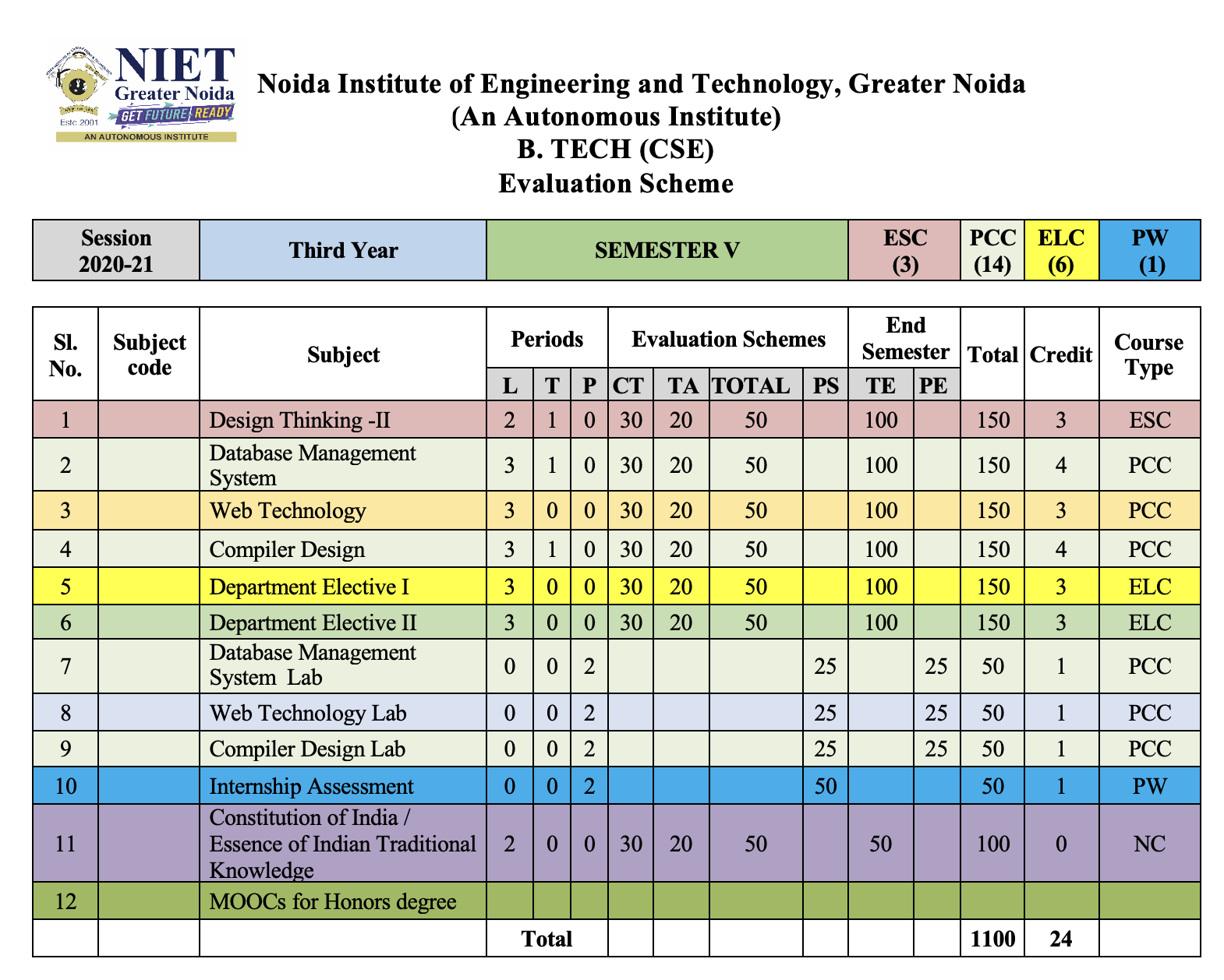
Evaluation Scheme

Slide 13
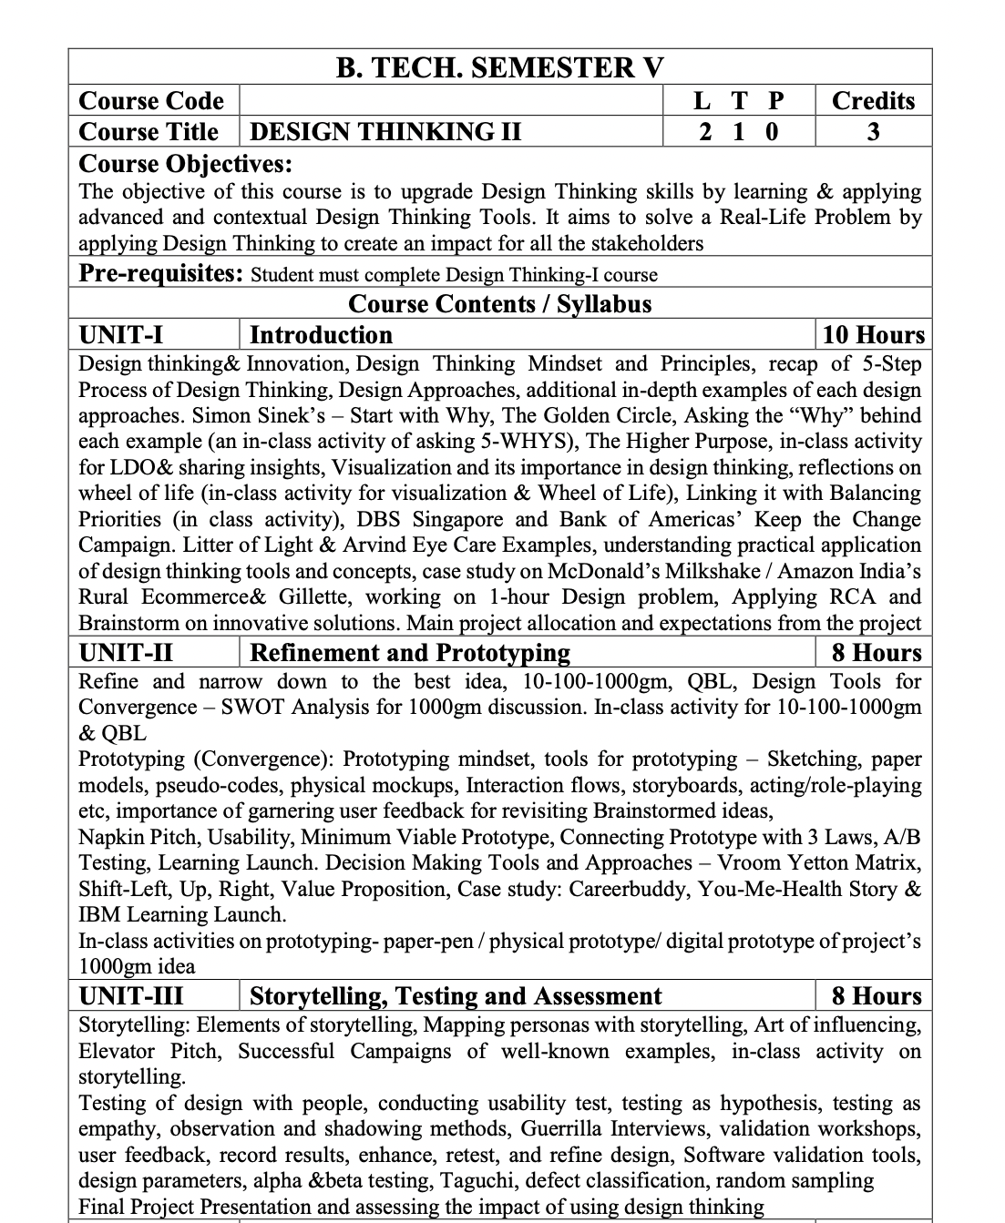
Syllabus

Slide 14
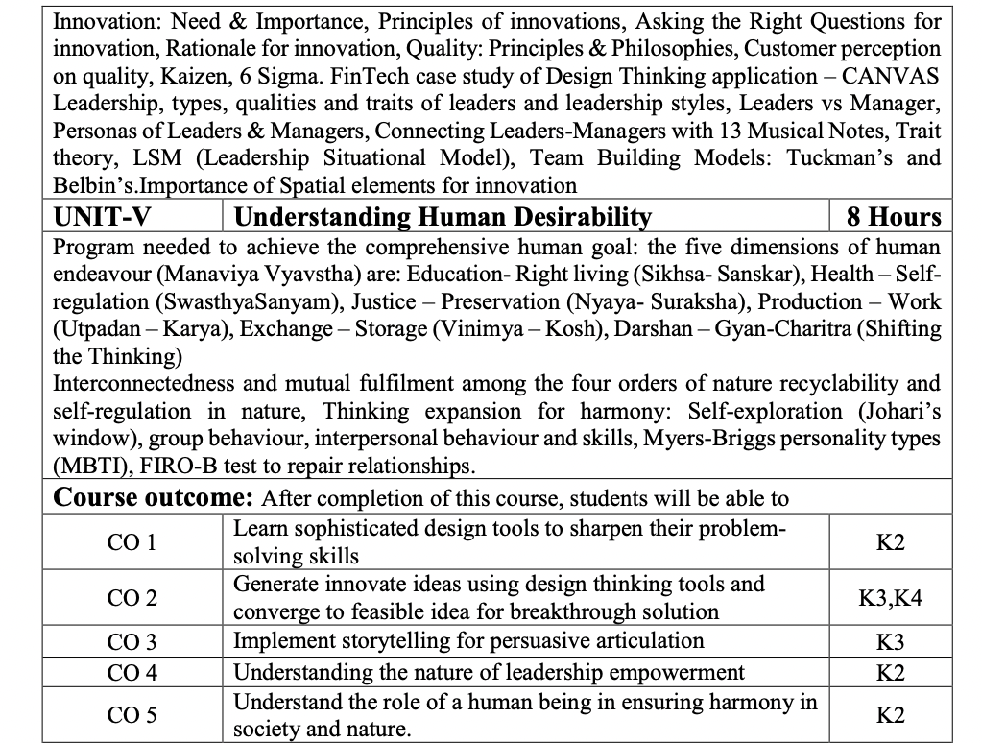
Syllabus

Slide 15
Content
Design thinking & Innovation
Design Thinking Mindset and Principles
Recap of 5-Step Process of Design Thinking
Design Approaches, additional in-depth examples of each design approaches
Simon Sinek’s – Start with Why
The Golden Circle
Asking the “Why” behind each example (an in-class activity of asking 5-WHYS)
The Higher Purpose
in-class activity for LDO & sharing insights
Visualization and it’s importance in design thinking, reflections on wheel of life (in-class activity for visualization & Wheel of Life)
Linking it with Balancing Priorities (in class activity)
DBS Singapore and Bank of Americas’ Keep the Change Campaign.
Litter of Light & Arvind Eye Care Examples
understanding practical application of design thinking tools and concepts
case study on McDonald’s Milkshake / Amazon India’s Rural Ecommerce & Gillette
working on 1- hour Design problem
Applying RCA and Brainstorm on innovative solutions.
Main project allocation and expectations from the project

Slide 16
Course Objective
The objective of this course is to upgrade Design Thinking skills by learning & applying advanced and contextual Design Thinking Tools.
It aims to solve a Real-Life Problem by applying Design Thinking to create an impact for all the stakeholders

Slide 17
Course Outcome
After completion of this course, students will be able to-
CO1: Learn sophisticated design tools to sharpen their problem- solving skills.
CO2: Generate innovate ideas using design thinking tools and converge to feasible idea for breakthrough solution.
CO3: Implement storytelling for persuasive articulation
CO4: Understanding the nature of leadership empowerment
CO5: Understand the role of a human being in ensuring harmony in society and nature.

Slide 18
Program Outcomes (POs)
Engineering Graduates will be able to:
PO1 : Engineering Knowledge
PO2 : Problem Analysis
PO3 : Design/Development of solutions
PO4 : Conduct Investigations of complex problems
PO5 : Modern tool usage
PO6 : The engineer and society

Slide 19
Program Outcomes (POs) cont…
Engineering Graduates will be able to:
PO7 : Environment and sustainability
PO8 : Ethics
PO9 : Individual and teamwork
PO10 : Communication
PO11 : Project management and finance
PO12 : Life-long learning

Slide 20
CO – PO and PSO Mapping
Design Thinking
CO.K | PO1 | PO2 | PO3 | PO4 | PO5 | PO6 | PO7 | PO8 | PO9 | PO10 | PO11 | PO12
ACSE0503.1 | 3 | 3 | 3 | 3 | 2 | - | - | - | 2 | 2 | - | 3
ACSE0503.2 | 3 | 3 | 3 | 3 | 2 | 2 | - | 1 | 1 | 1 | - | 3
ACSE0503.3 | 3 | 3 | 2 | 3 | 3 | 2 | - | 2 | 1 | 1 | 2 | 3
ACSE0503.4 | 3 | 3 | 3 | 3 | 2 | 2 | - | 2 | 2 | 1 | 3 | 3
ACSE0503.5 | 2 | 2 | 2 | 2 | 2 | 2 | - | 2 | 1 | 1 | 1 | 2
Average | 2.8 | 2.8 | 2.6 | 2.8 | 2.2 | 1.6 | - | 1.8 | 1.4 | 1.2 | 1.2 | 2.8

Slide 21
Program Educational Objectives (PEOs)
Program Educational Objectives (PEOs) | PEOs Description
PEOs | To have an excellent scientific and engineering breadth so as to comprehend, analyze, design and provide sustainable solutions for real-life problems using state-of-the-art technologies.
PEOs | To have a successful career in industries, to pursue higher studies or to support entrepreneurial endeavors and to face the global challenges.
PEOs | To have an effective communication skills, professional attitude, ethical values and a desire to learn specific knowledge in emerging trends, technologies for research, innovation and product development and contribution to society.
PEOs | To have life-long learning for up-skilling and re-skilling for successful professional career as engineer, scientist, entrepreneur and bureaucrat for betterment of society.

Slide 22
End Semester Question Paper Template
B TECH
(SEM-V) THEORY EXAMINATION 20__-20__
COMPILER DESIGN
Time: 3 Hours Total Marks: 100
Note: 1. Attempt all Sections. If require any missing data; then choose suitably.
SECTION A
Attempt all questions in brief. 2 x 10 = 20
Q.No. | Question | Marks | CO
1 |  | 2
2 |  | 2
. |  | .
10 |  | 2
Surbhi Jha Code has not been allotted yet Unit-I

Slide 23
End Semester Question Paper Templates
SECTION B
2. Attempt any three of the following: 3 x 10 = 30
SECTION C
3. Attempt any one part of the following: 1 x 10 = 10
Q.No. | Question | Marks | CO
1 |  | 10
2 |  | 10
. |  | .
5 |  | 10
Q.No. | Question | Marks | CO
1 |  | 10
2 |  | 10
Surbhi Jha Code has not been allotted yet Unit-I

Slide 24
Prerequisite and Recap
Pre-requisites: Student must complete Design Thinking-I course
Recap:
Million Dollar Idea
Empathy maps
Mind-Map
CATWOE Analysis

Slide 25
Brief Introduction about the subject with videos
Design Thinking is an iterative method of deeply empathizing with people's needs/wants/problems, and developing/testing solutions that meet those needs. And it's not just for designers, tech companies, or design-centered organizations.
https://uxplanet.org/how-to-solve-a-product-design-challenge-22c4daa27117
https://www.youtube.com/watch?v=6_mHCOAAEI8

Slide 26
Unit Objective
.
To get detailed insights of design thinking approaches, tools related to it and balancing the priorities.

Slide 27
Topic Objective
Design thinking & Innovation, Design Thinking Mindset and Principles, recap of 5-Step Process of Design Thinking, Design Approaches, additional in-depth examples of each design approaches. Simon Sinek’s – Start with Why, The Golden Circle, Asking the “Why” behind each example (an in-class activity of asking 5-WHYS), | To learn different types of design approaches
The Higher Purpose, in-class activity for LDO & sharing insights, Visualization and it’s importance in design thinking, reflections on wheel of life (in-class activity for visualization & Wheel of Life) | To learn different types of tools
Linking it with Balancing Priorities (in class activity), DBS Singapore and Bank of Americas’ Keep the Change Campaign. Litter of Light & Arvind Eye Care Examples, understanding practical application of design thinking tools and concepts, case study on McDonald’s Milkshake / Amazon India’s Rural Ecommerce & Gillette, working on 1- hour Design problem, Applying RCA and Brainstorm on innovative solutions. Main project allocation and expectations from the project | To understand decision making tools

Slide 28
Recap: Million Dollar Idea Tool (CO1)

Slide 29
Recap: Empathy Map (CO1)
A simple, easy-to-digest visual that captures knowledge about a user’s behaviors and attitudes.
Helps designers see things from the user’s perspective.
An active ingredient during Listening, Dialogue, Observation
Used right from the outset of the Design Thinking Process to help the Design Thinker develop empathy, understanding, experiences, insights and observations.
But...
It is an iterative tool. Users can go back to the map and refine it as and when they notice something new during a dialogue or interaction with the user.

Slide 30
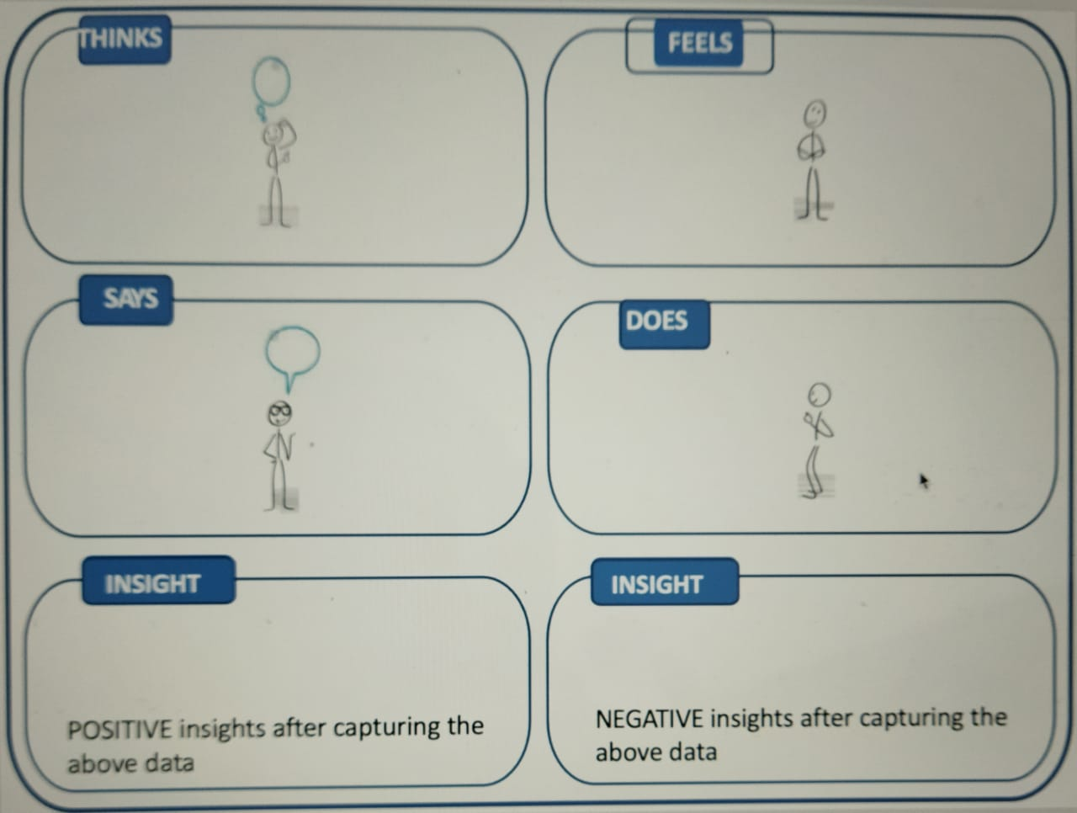
Recap: Empathy Map Cont…(CO1)

Slide 31
Recap: Mindmap
Great tool for ideating & getting unstuck.
Simple free association of words, one after another, to open up idea space.
Being visual, generates lots of ideas by bypassing the inner logic / verbal sensor.
Tool to represent how ideas are linked to each other and to the central idea.
Used to generate, visualize, structure and classify items.
Helps to look for patterns & insights.
Displays data, clusters them and helps themes & patterns to emerge Provides decision criteria.
Success lies in being a team activity.
Taps into the power of visualization.

Slide 32
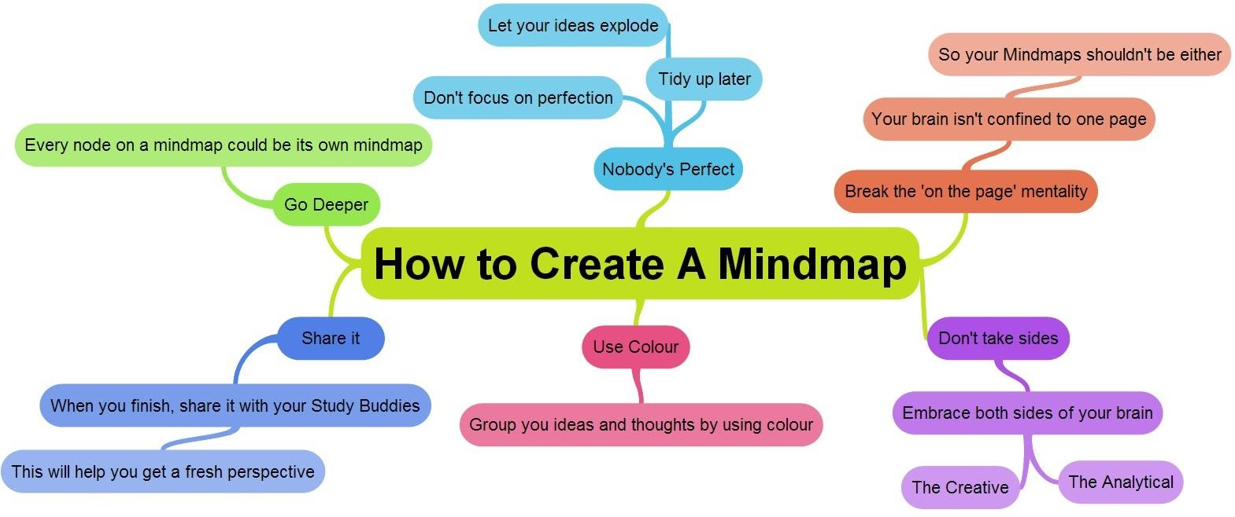
Recap: Mindmap Cont... (CO1)

Slide 33
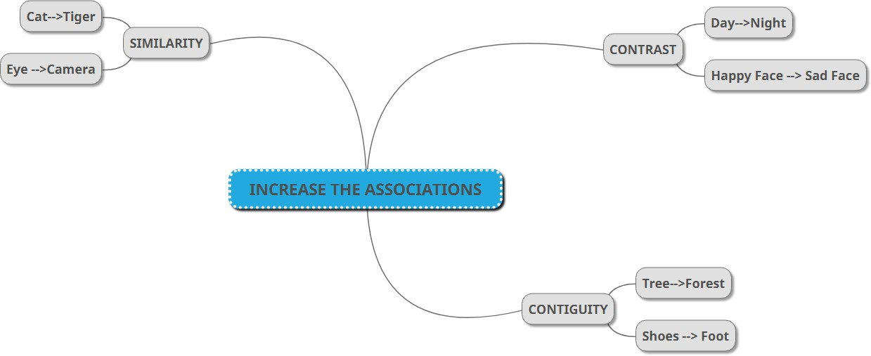
Recap: Mindmap Example (CO1)

Slide 34
Recap: CATWOE Analysis (CO1)
CATWOE Analysis technique was considered as one of the important part of SSM approach while identifying stakeholders in solving problems.
Enlists all the stakeholders who would be affected while solving problems & understand their perspective
Helps to avoid the personal bias/beliefs of problem solvers as they critically discuss each element of CATWOE
Unearths the bigger picture with regards to constraints, challenges, possible outcomes and their effects on the stakeholder(s)
Understand the conflicts between stakeholders, their roles, conflicts in roles & possible actions (they might take) during the process of problem solving

Slide 35
Recap: CATWOE uses (CO1)
To solve any complex problem where multiple stakeholders are involved.
To change an existing system impacting a variety of people.
To enable Change Management for better adoption of change by stakeholders.
Used in typical Project Management.
To launch a concept that will radically change the existing system.

Slide 36
Recap: Elements of CATWOE (CO1)
The ‘CAT’
Customers
Those who face the current problem for whom you will be working on the solution.
Those who will be using your solution
Those directly affected by your idea
Actors
Those who actually implement the solution/transformation
Transformation
Does not involve writing any stakeholder; but write in clear-cut terms about the Why, What, How of the problem and the solution/transformation you wish to bring to solve
By clearly thinking and writing, you will think of stakeholders who can be classified in other elements

Slide 37
Recap: Elements of CATWOE (CO1)
The ‘WOE’
Worldview
Very important during analysis when thinking beyond the system
Considering stakeholders beyond current system who will be affected indirectly by solution/transformation
Think of the bigger picture (beyond the system)
Owners
Stakeholders who own the permission to start/stop/pause/cancel your transformation / solution
Leaders who have the ability to guide the solution as well as block it
Environment Constraints
Constraints (legal, political, ethical, regulation, norms, financial, human power, etc.) or rules that may hinder solution implementation

Slide 38

Design Thinking Introduction(CO1)
Design is a process of working to develop solutions in a conscious and innovative way in which both functional and aesthetic requirements are included based on user needs.
Human Centered
Future Focused
Creates Value

Slide 39
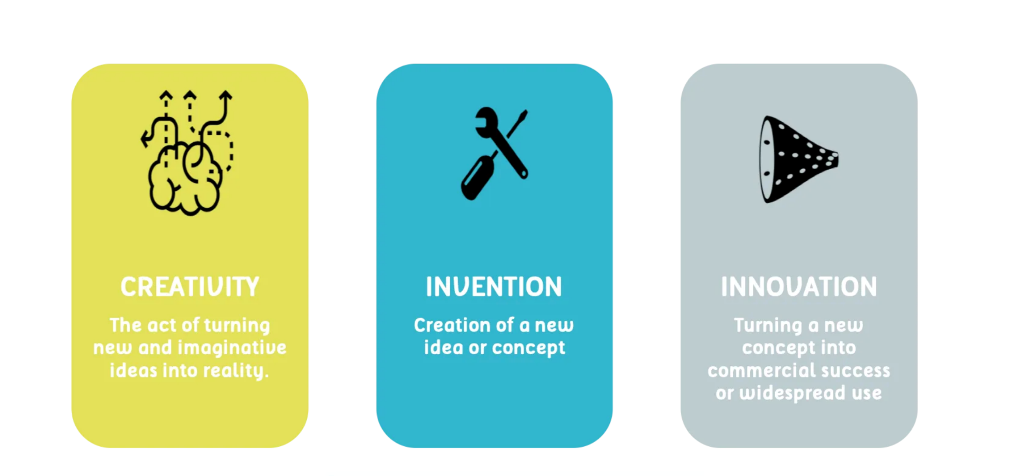
Innovation and Creativity(CO1)

Slide 40
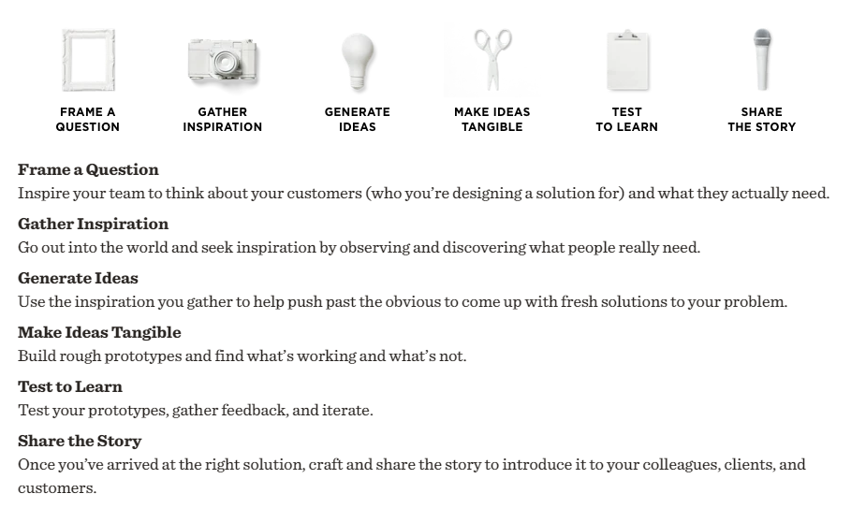
Design Mindset (CO1)

Slide 41
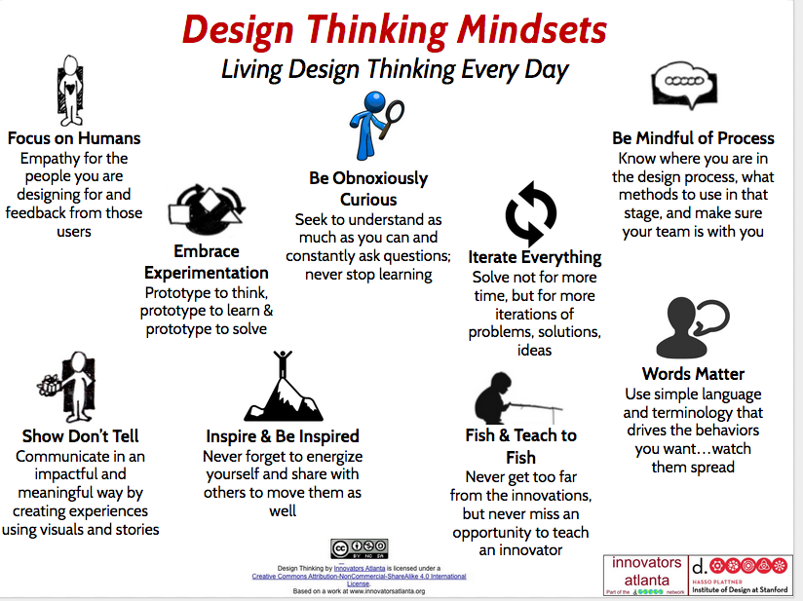
Design Thinking Mindset(CO1)

Slide 42
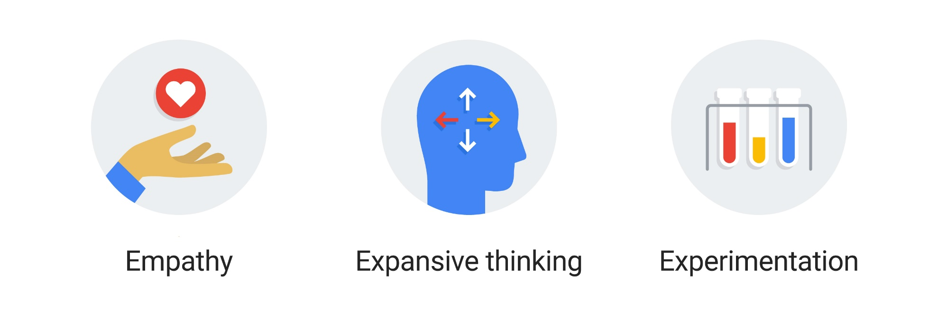
3 Core Design Thinking Principles(CO1)

Slide 43
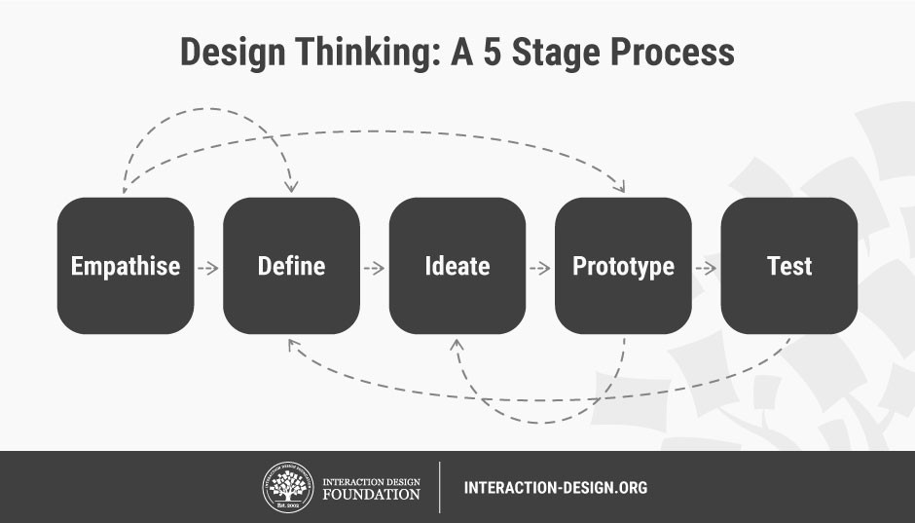
Design Thinking model :
Hasso-Plattner Institute of Design at Stanford

Slide 44
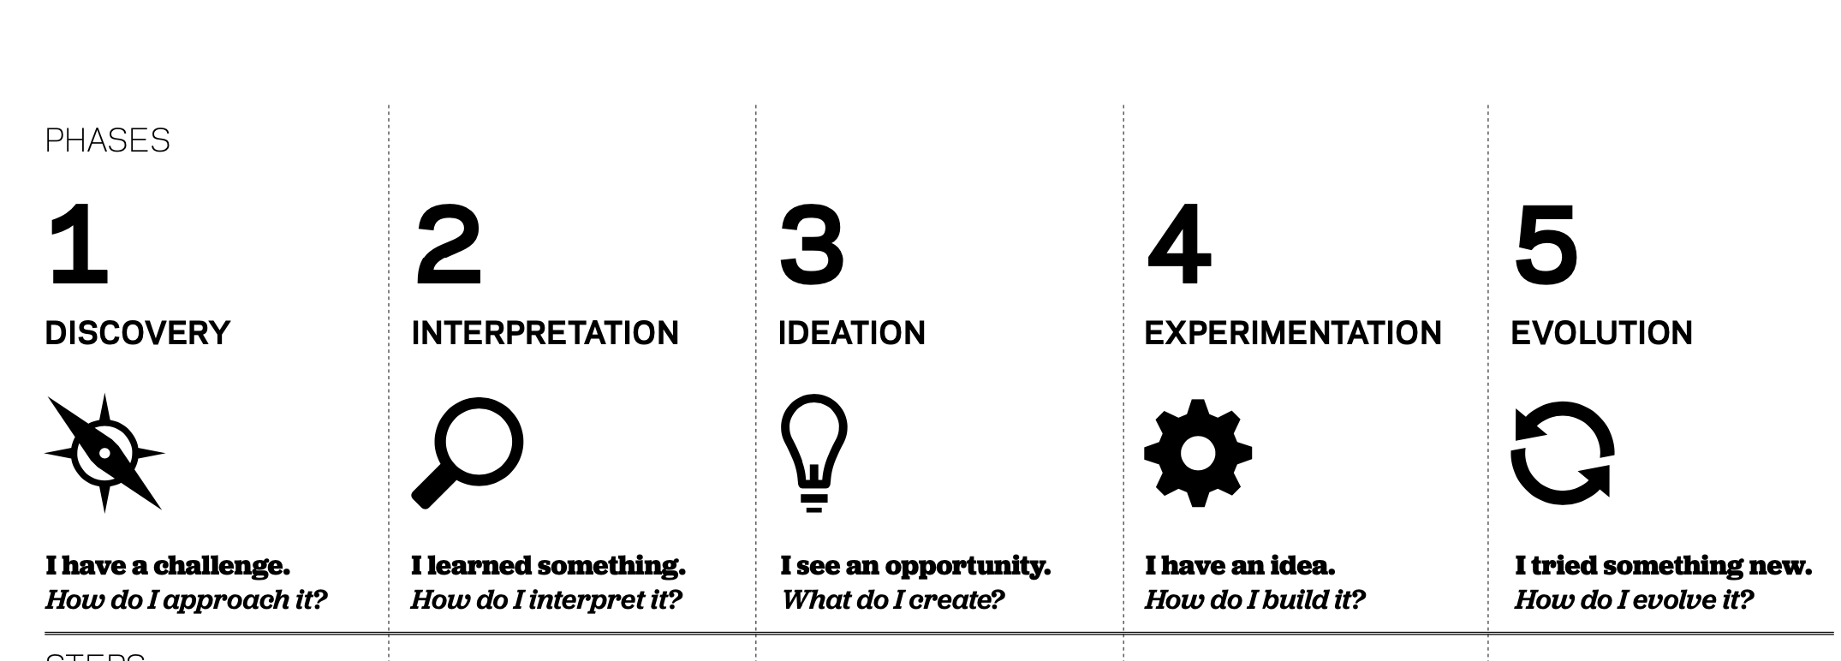
Design Thinking Model: IDEO (CO1)

Slide 45
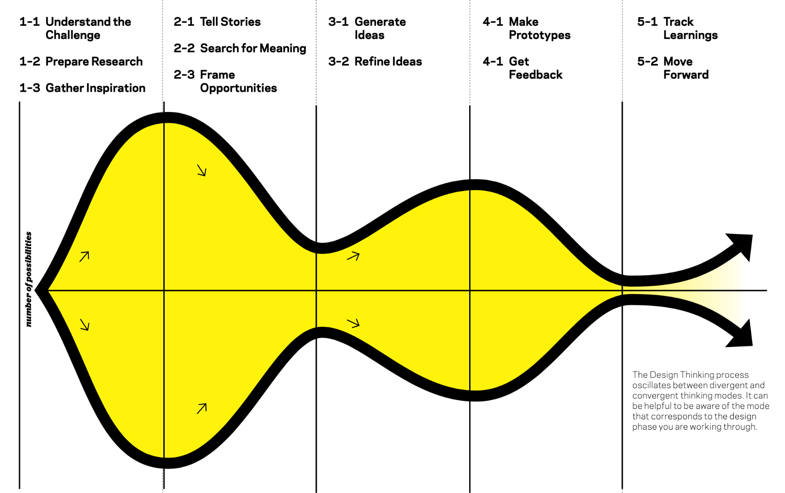
Design Thinking Model: IDEO (CO1) Cont….

Slide 46
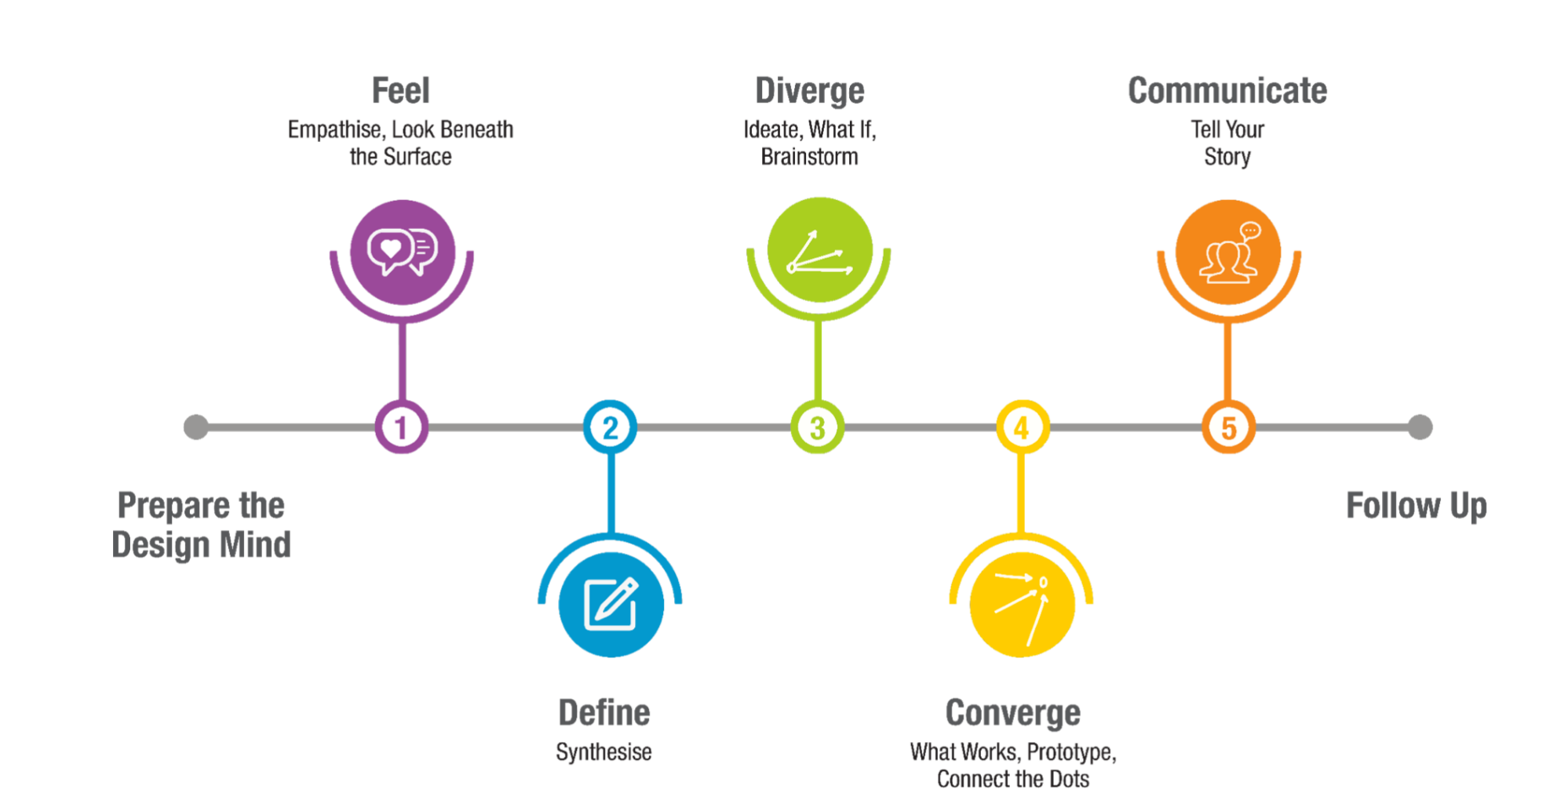
Design Thinking Process: School of Design Thinking(CO1)

Slide 47
Daily Quiz
Design is a process of working to develop solutions in a conscious and innovative way in which both _____and ______ requirements are included based on user needs.
functional and aesthetic
Customer and seller
Weak and strong
Good or Bad
Design Thinking typically helps in _______
Innovation
Creativity
Dialogue
Observation

Slide 48
Daily Quiz
Design thinking is often also called________
Human Centred design
Ecological sustainability
Alien diversity
Intellectual property
What is Innovation?
The process of turning a new concept into commercial success or widespread use.
The creation of a new idea or concept.
The act of turning new and imaginative ideas into reality.
None of the above

Slide 49
Simon Sinek’s – Start with Why (CO1)
Start with Why shows that the leaders who’ve had the greatest influence in the world all think, act, and communicate the same way—and it’s the opposite of what everyone else does. Sinek calls this powerful idea The Golden Circle, and it provides a framework upon which organizations can be built, movements can be led, and people can be inspired. And it all starts with WHY.

Slide 50
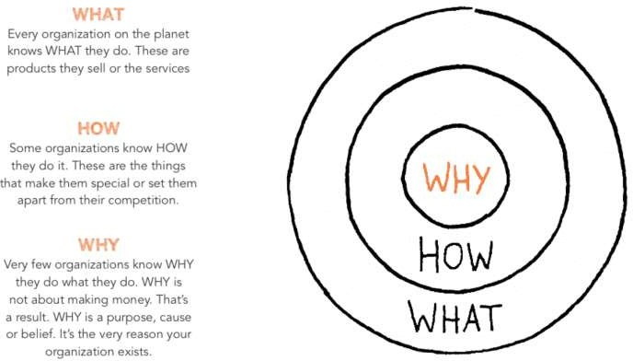
The Golden Circle (CO1)

Slide 51
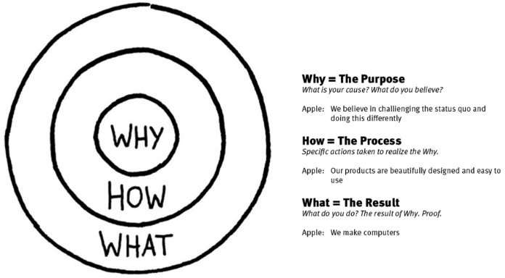
Simon Sinek – The Golden Circle (CO1)

Slide 52
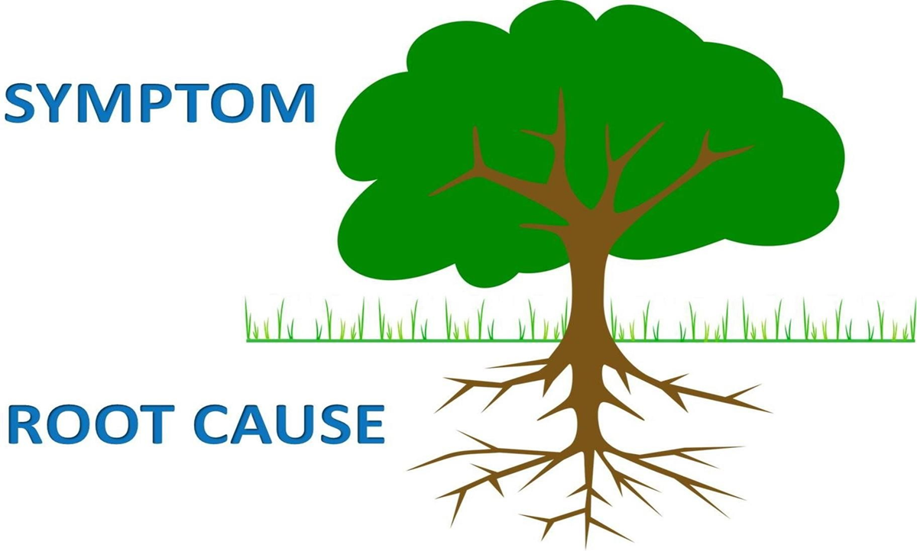
Asking the “Why” behind each example (5-WHYS)
(CO1)

Slide 53

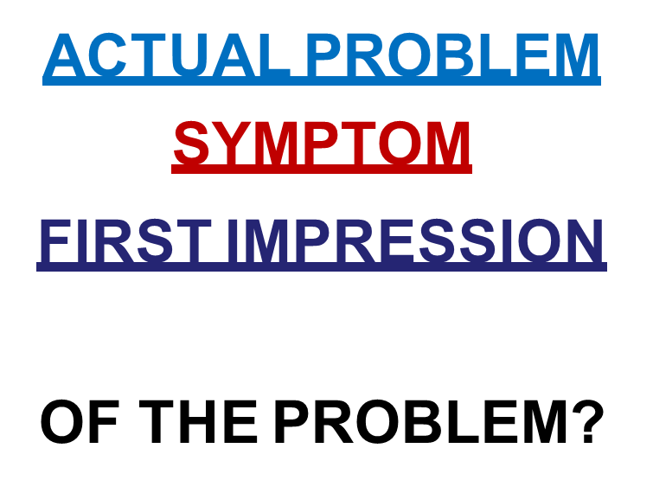
Asking the “Why” behind each example Cont…(5-WHYS)
(CO1)

Slide 54
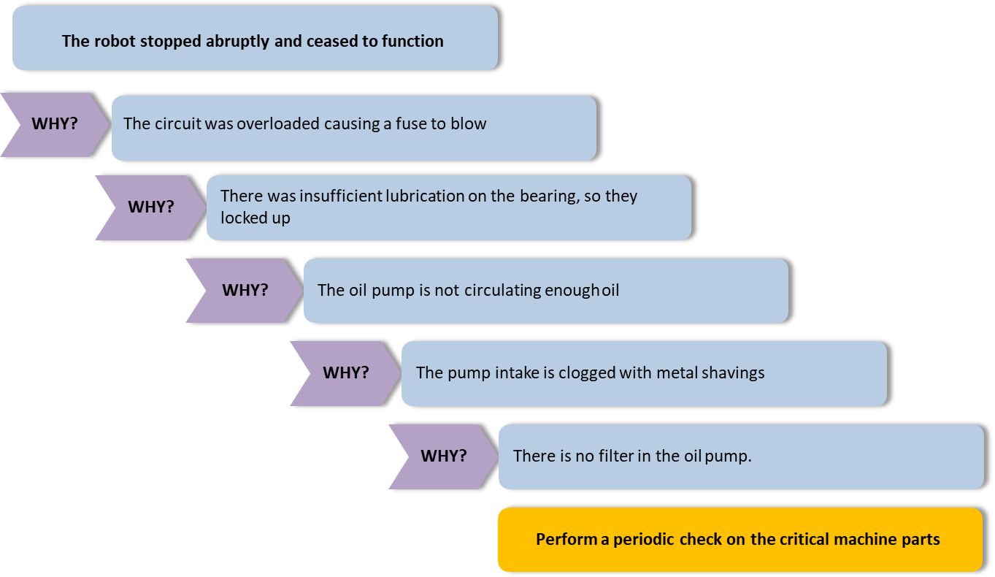
5-WHYS example (CO1)

Slide 55
Weekly Assignment
Explain Design thinking & Innovation.
Summarize Design Thinking Mindset and Principles.
Discuss 5-Step Process of Design Thinking.
Briefly describe Design Approaches.
Illustrate examples of each design approaches.
Describe Simon Sinek’s – Start with Why
Analyze ”The Golden Circle”.

Slide 56
Weekly Assignment
Explain Design thinking & Innovation.
Summarize Design Thinking Mindset and Principles.
Discuss 5-Step Process of Design Thinking.
Briefly describe Design Approaches.
Illustrate examples of each design approaches.
Describe Simon Sinek’s – Start with Why
Analyze ”The Golden Circle”.

Slide 57
Weekly Assignment
Explain Design thinking & Innovation.
Summarize Design Thinking Mindset and Principles.
Discuss 5-Step Process of Design Thinking.
Briefly describe Design Approaches.
Illustrate examples of each design approaches.
Describe Simon Sinek’s – Start with Why
Analyze ”The Golden Circle”.

Slide 58
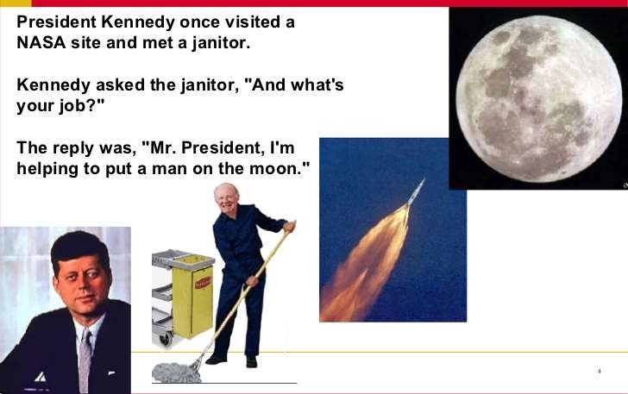
The Higher Purpose (CO1)

Slide 59
Class Activity (CO1)
LDO & sharing insights

Slide 60
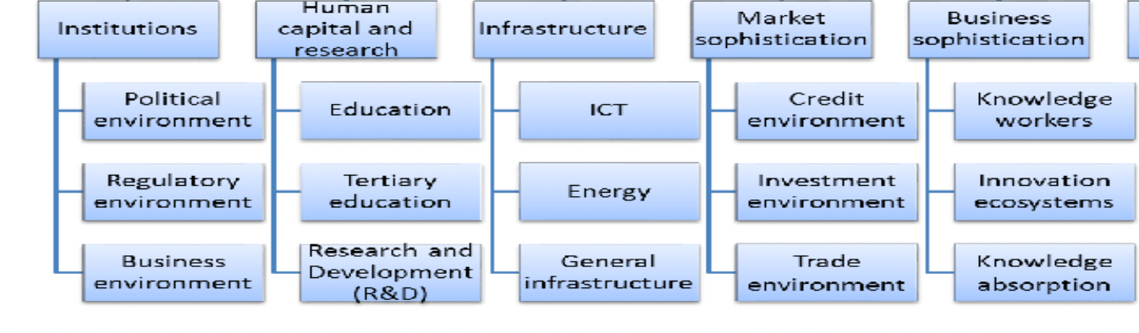
LD0 Framework Example for Innovation Input Index(CO1)

Slide 61
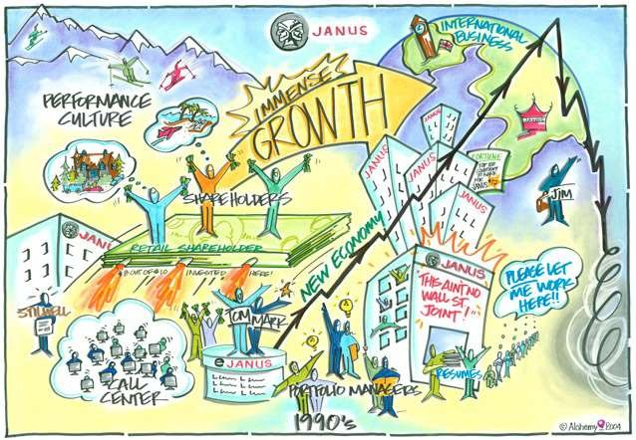
VISUALIZATION - Dream after 5 / 10 years….. (CO1)

Slide 62
Visualization (CO1)
Visualization is about using images. It’s not about drawing; it’s about visual thinking. It pushes us beyond using words or language alone. It is a way of unlocking a different part of our brains that allows us to think nonverbally and that managers might not normally use.

Slide 63
Visualisation importance in design thinking (CO1)
Understand the problem
Idea generation
Build and test solutions

Slide 64
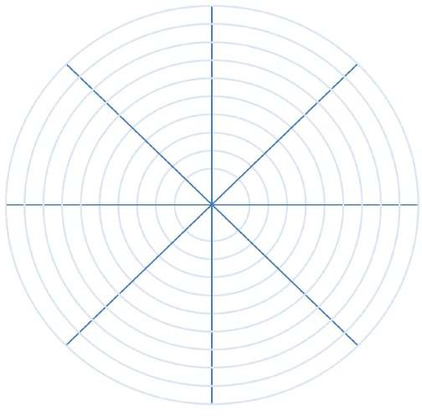
WHEEL OF LIFE – How much time are we devoting to priorities? (CO1)
Learning
Fitness
Career
Family
Week 1
Week 2
0 – 10 rating

Slide 65
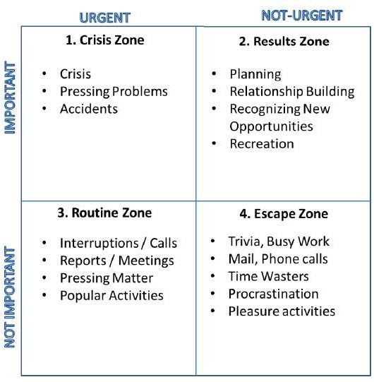
BALANCING PRIORITIES – 4 Quadrants of Stephen Covey (CO1)

Slide 66
Daily Quiz
The golden circle has three layers______, _____ & ______ .
Why, how and what
More, much and less
Good, Bad and worst
There, here and where
________ is a core component of the way that we communicate, whether we're aware of it or not.
Visualisation
Dialogue
Observation
Empathy

Slide 67
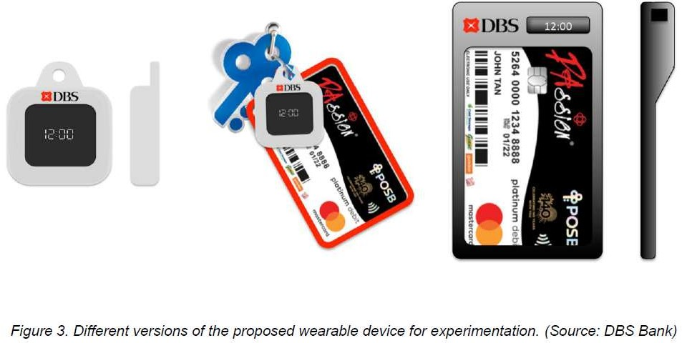
DBS SINGAPORE – Banking for the Elders (CO1)

Slide 68
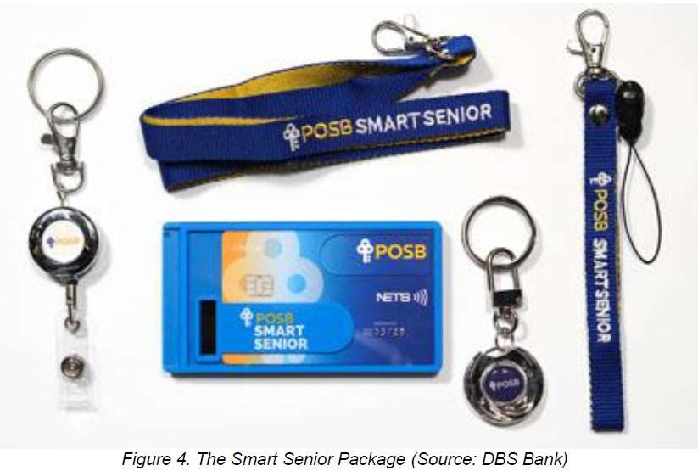
DBS SINGAPORE – Banking for the Elders (CO1)

Slide 69

KEEP THE CHANGE – Bank Of America (CO1)

Slide 70
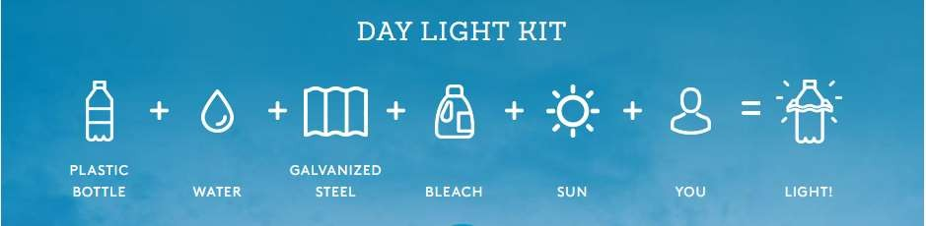

LITER OF LIGHT – Low Cost Power of Light (CO1)

Slide 71
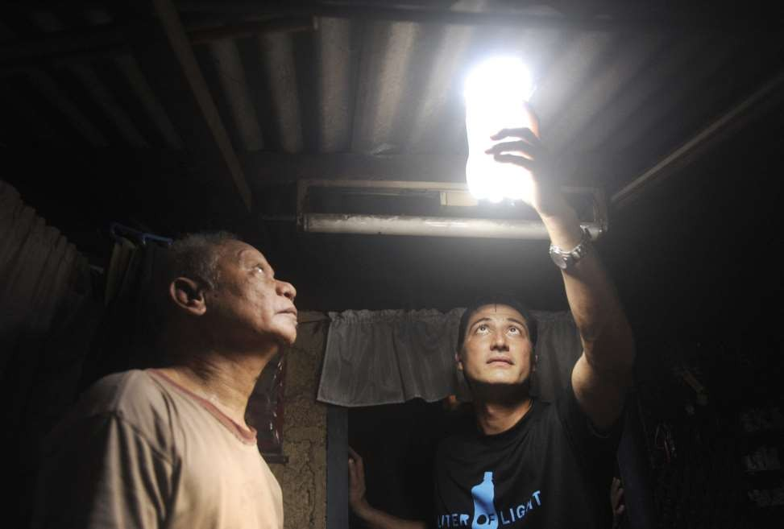

LITER OF LIGHT – Low Cost Power of Light (CO1)

Slide 72

ARAVIND EYE CARE – Affordable & Efficient (CO1)

Slide 73
Daily Quiz
“The problem of avoidable blindness rapidly escalating remained a major cause of concern in the Indian healthcare scenario”. This statement belongs to _______ .
Aravind Eye Care
Fortis
AIIMS
Escort
__________first initiative failed to produce more sales because they didn’t ask their customers the right questions.
McDonalds’
Dominos
KFC
Pizza Hut

Slide 74
Weekly Assignment
Discuss the “Why” behind each example (5-WHYS).
Describe the Higher Purpose.
Explain Visualization and it’s importance in design thinking.
Illustrate reflections on wheel of life (in-class activity for visualization & Wheel of Life).
How we can link reflection of wheels with Balancing Priorities.
Summarize DBS Singapore and Bank of Americas’ Keep the Change Campaign.
Discuss Litter of Light & Arvind Eye Care.

Slide 75
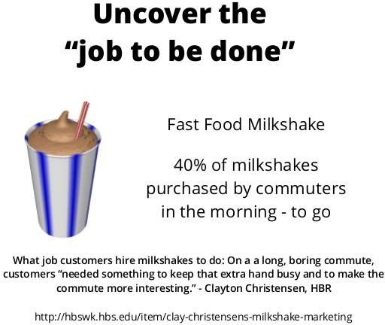
McDonald’s Milkshake – Job to be done theory (CO1)

Slide 76
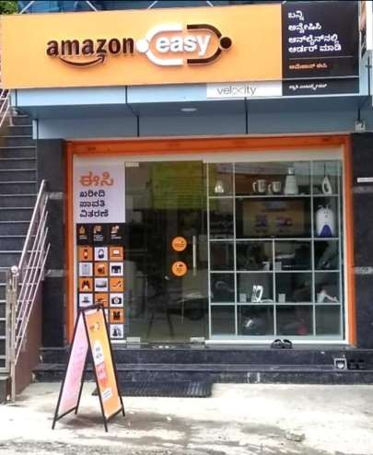
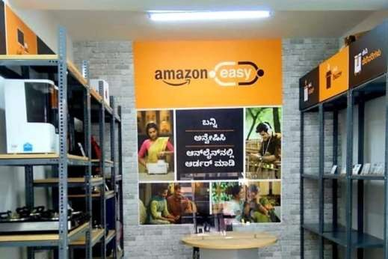
Amazon Easy Model E-Commerce for Rural India (CO1)

Slide 77
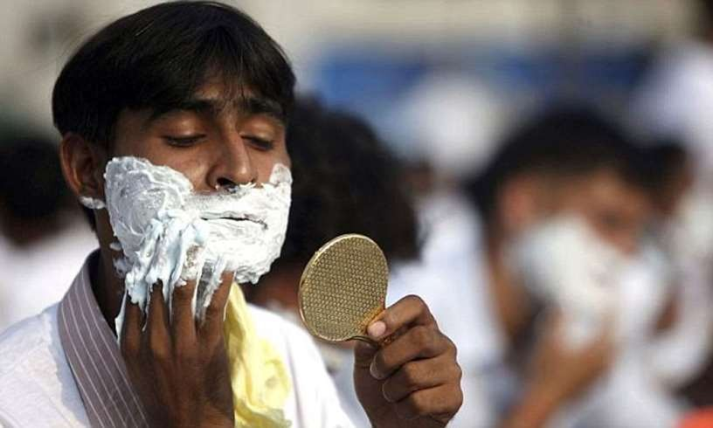
Gillette – Safety First (CO1)

Slide 78
Design Thinking Case Study – CareerBuddy(CO1)
Case Focuses on failures of application –
Did not prioritize experience for users
Didn’t prototype in iterative ways
Didn’t engage all stakeholders
Designed overly complex system

Slide 79
Design Thinking Case Study – Me You Health Story(CO1)
Case Focuses on
Development of an program (leveraging technology & social media) for healthier lifestyle.
Conducted Research for their target users (ethnographic research) – unstated needs
Importantly, they told users to visualize their well-being (after 5 years)
Health is emotional subject – Case focuses on how stimuli was given to participants to garner their ideas about their health
Arrived at 7 different personas depending on multiple factors
What appealed to one persona totally differed to what appealed to other persona
Gamification for Minimum Viable Prototype – Fail Fast Fail Quickly (making small incremental changes)
This helped to arrive at notification time-table, reminders for exercises, small tasks about fitness etc.
Platform uses technology, social feedback, app(s) etc for their users

Slide 80
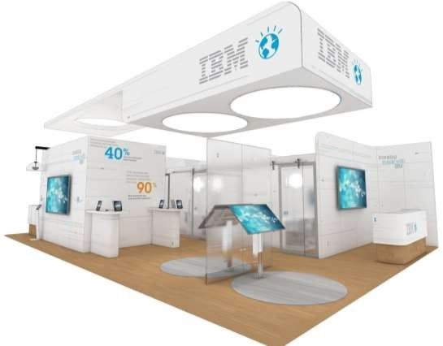
Design Thinking Case Study - IBM Learning Launch(CO1)

Slide 81
Design Thinking Case Study – CANVAS (INTELLECT DESIGN ARENA LTD.)(CO1)
Case Focuses on
Application of Design Thinking & IT / FinTech
Framework of Unstated Needs (COPARIS) : Non Functional Requirements
Story of how we arrived at that framework & conversation with a CIO of bank
Customer First Approach reflecting User-Centric Design
Framework for seamless experience across different operating systems
Moving from Mystery to Algorithm
Prototyping ,User Journeys, Last 2% for end-users
Storytelling for internal users

Slide 82

Writable Spaces – Transparent Glass (CO1)

Slide 83

Writable Spaces – Writable Walls (CO1)

Slide 84
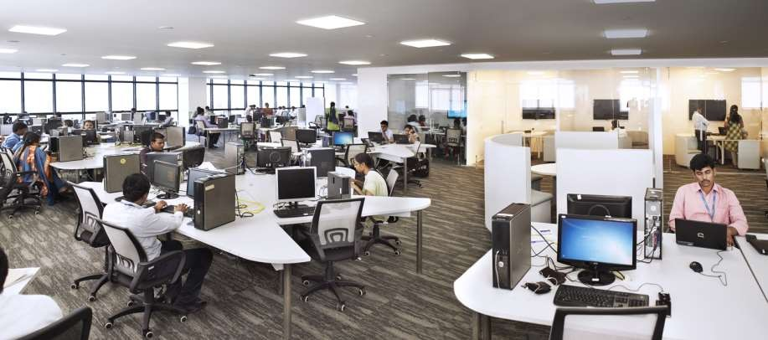
Collaborative Seating Arrangements (CO1)

Slide 85
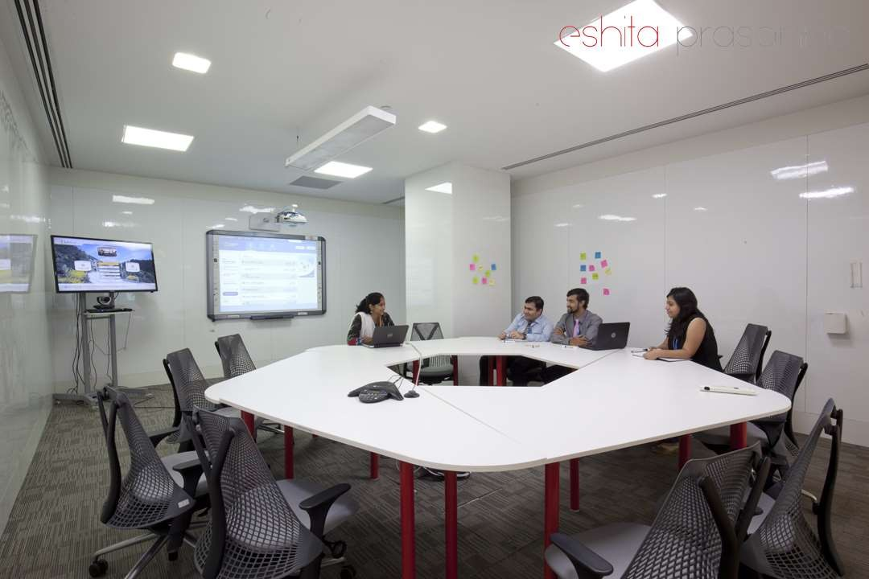
Collaborative Seating Arrangement (CO1)
Collaborative Seating Arrangement

Slide 86

Connecting the dots – Different screens to present effectively(CO1)

Slide 87
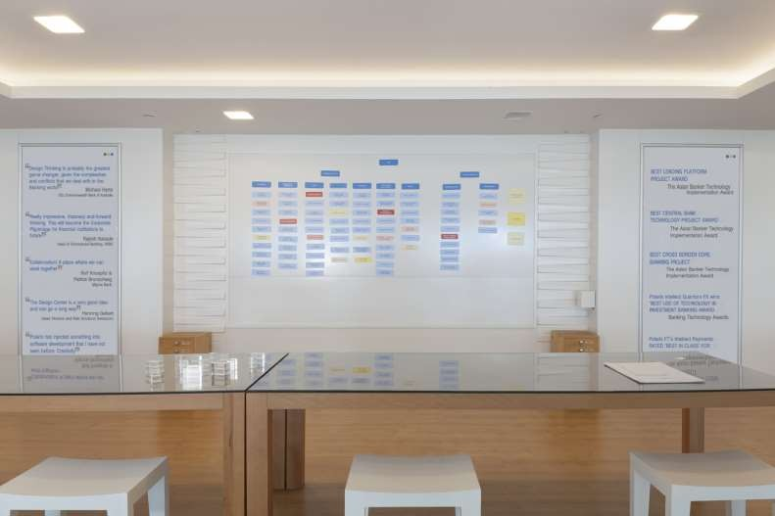
Collaborative discussions through Magnetic Wall (CO1)

Slide 88
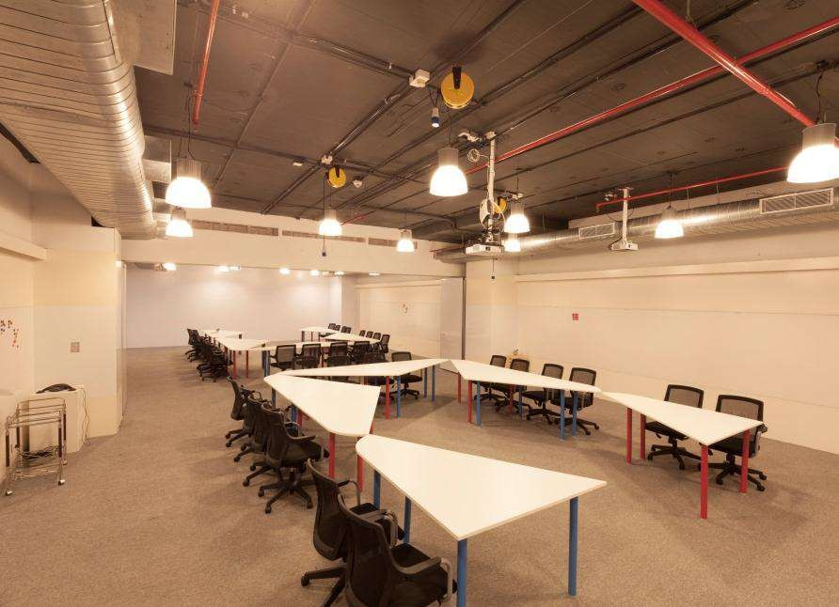
Collaborative discussions through Workshop Rooms – Writable Walls (CO1)

Slide 89
working on 1- hour Design problem(CO1)
A Design Challenge is a way for employers to assess how well you approach design problems and is often a good way to put your skills to the test.
STEPS
Start by taking a first stab at writing your design challenge down. It should be short and easy to remember. Try composing a single sentence that conveys the problem you want to solve. We often phrase these as How Might We questions to set our teams up to be solution-oriented and to generate a lot of ideas along the way.
Now that you have a draft of your design challenge, explore and align on the goal or outcome you hope to achieve. Use the Align on your Impact Goals activity to ensure that you, your team and any other stakeholders have the same vision of success in mind.

Slide 90
working on 1- hour Design problem Cont…(CO1)
Next you’ll want to think about the audience you’re aiming to serve and the context, constraints, and influences in their lives. Use the Define your Audience activity to map the ecosystem around your user and the shifts or changes that you might need to influence through your design. This step will help you see how broad or narrow your challenge scope needs to be.
Now that you’ve gathered and organized more information, review your design question and see if it still feels right. Refine your question and capture this, and the information you used to get there, in your Frame Your Design Challenge worksheet.
Framing the right design challenge is key to arriving at a good solution. A quick test we often run on a design challenge is to see if we can come up with five possible solutions in just a few minutes. If so, you’re likely on the right track. Try this, and make tweaks as needed to get to the right framing and scope.

Slide 91
Applying RCA (CO1)
Root cause analysis (RCA) is a method of problem solving used for identifying the root causes of faults or problems.
Steps to Apply the 5 Whys Tool
Step 1: Define the Problem
Step 2: Ask the Why questions
Step 3: Discussing the results

Slide 92
Brainstorming (CO1)
Brainstorming is a great way to come with a plenty of ideas that you would not be able to generate by just sitting down with a pen and paper.
The intention of brainstorming is to leverage the collective thinking of the group by engaging with each other, listening and building on other ideas.
Brainstorming can be used throughout the Design Thinking process to come up with a Design Solution.
Brainstorming comes in handy when you need to come up with ideas.
But have you ever been in one of those brainstorms where you ended up feeling totally blank or, even worse, more confused?

Slide 93
Effective Brainstorming (CO1)
Can be done for a well-defined problem or issue.
Also can be done for a problem/issue that has several possible solutions.
Can happen only with few constraints.
Comes to play when there is a need to generate ideas.
Happens best in reasonably larger groups.

Slide 94
Brainstorming: Do’s (CO1)
1. APPOINT A FACILITATOR
During a brainstorm, there should be someone to lead the group.
It doesn’t have to be the same person as the decision maker, but it should be the one who is able to guide through each topic or agenda as well as build up a positive atmosphere in the room.
The facilitator should also be the one who knows skills and expertise of people in the room, so that he/she could make the best out of everyone’s potential.

Slide 95
Brainstorming: Do’s (CO1)
2. BUILD ON EACH OTHER’S IDEA
What’s expected from a brainstorm is ideas. Many of them.
But rather than just throwing one idea after another, try breaking them down or building them up so that you can see where they’re linked together, and it helps you to see a bigger picture as well.
Moreover, by breaking down or building up ideas, everyone has a chance to participate and witness the evolution of that idea together.
3. WRITE AND DRAW
Visualizing ideas help different interpretations come to light and spark conversation.
Display them by writing down or drawing them in one place where everyone can see, so that they can feel involved as a contributor and no idea gets lost during the process.

Slide 96
Brainstorming: Dont’s (CO1)
1. FORCE PARTICIPATION
Force participation, like assigning participants with a turn to speak, will not help generating ideas but add social pressure to the group and kill the organic flow of a conversation instead.
2. CRITICIZE OTHER PEOPLE’S IDEAS
A brainstorm should be focusing on generating ideas rather than criticizing them.
Avoid making comments on other people’s opinions as stupid or useless. It’ll destroy the atmosphere of collaboration and intimidate others, making them afraid of sharing their ideas.
HOLD THE SESSION IN THE EVENING
A lot of people may overlook this point, but it’s very important when the brainstorming session is happening.
Try to avoid holding the session in the evening, especially at the time close to the end of business hours, since people could be distracted by their plans after work and be unable to focus.

Slide 97
Applying RCA and Brainstorm on innovative solutions (CO1)
The Department of science and technology within the government of INDIA has developed the INDIA INNOVATION INITIATIVE (i3) to create an innovation network, encouraging and promoting innovators and commercialization across the country.
The global innovation index aims to capture the multi dimensional facets of innovation and provide the tools that can assists in tailoring policies or promote long term output growth, improved productivity, and job growth.

Slide 98
Main project allocation and expectations from the project (CO1)

Slide 99
Expectations from the project (CO1)
To make the student understand areas of life that are important, the roles they play in their life.
After completing it is time to plan the actions needed to work on regaining balance in the student’s life.
Then the students have to Start with the neglected areas, what things they require to start doing to regain balance?
In the areas that currently sap energy and time, student can stop doing or reprioritize or delegate to someone else.
They have to make a commitment to these actions by writing them in the worksheet.

Slide 100
Weekly Assignment
Discuss practical application of design thinking tools and concepts.
Explain case study on McDonald’s Milkshake.
Illustrate Amazon India’s Rural Ecommerce.
Summarize case study on Gillette.
What does it mean working on 1- hour Design problem.
How we can apply RCA.
Brainstorm on innovative solutions.

Slide 101
Faculty Video Links, Youtube & NPTEL Video Links and Online Courses Details
Youtube/other Video Links
https://nptel.ac.in/courses/110106124
https://designthinking.ideo.com/
https://www.rca.ac.uk/study/programme-finder/design-thinking-innovation-collaboration-design-museum/
https://www.designkit.org/methods/frame-your-design-challenge
https://uxplanet.org/design-principles-root-of-the-problem-3389991c9e50#:~:text=Root%20cause%20analysis%20(RCA)%20is,causes%20of%20faults%20or%20problems%E2%80%A6&text=RCA%20allows%20us%20to%20understand,that%20caused%20the%20whole%20mess.

Slide 102
Daily Quiz
Use the ________ tool to assess your level of satisfaction or creative fulfillment in each area of your life.
wheel of life assessment
RCA
Brainstorming
None of the above
_________ is a method of problem solving used for identifying the root causes of faults or problems.
Root cause analysis
LD0
Golden Circle
None of the above

Slide 103
Glossary Question
Brainstorming, Design Challenge, Discovery, Empathize
_______ is a first step of Design thinking Process in IDEO approach
_______ is the first step in the Design Thinking Process.
_______ is a great way to come with a plenty of ideas that you would not be able to generate by just sitting down with a pen and paper.
_______ is a way for employers to assess how well you approach design problems and is often a good way to put your skills to the test.

Slide 104
Expected Questions for University Exam
Discuss Design thinking & Innovation.
Define Design Thinking Mindset and Principles related to it.
Illustrate 5-Step Process of Design Thinking.
Summarize Design Approaches examples.
Explain Simon Sinek’s – Start with Why.
Elaborate the concept of The Golden Circle.
Analyse Root cause analysis.
Discuss “The Higher Purpose”.
Explain LDO.

Slide 105
Expected Questions for University Exam
Explain Visualization and it’s importance in design thinking,
Discuss reflections on wheel of life.
Linking it with Balancing Priorities.
Discuss the case study of DBS Singapore and Bank of Americas’ Keep the Change Campaign.
Memorize Litter of Light & Arvind Eye Care.
What do you understand by practical application of design thinking tools?
Describe the case study on McDonald’s Milkshake.
Explain the case study on Amazon India’s Rural Ecommerce
Discuss Gillette case study.
Summarize working on 1- hour Design problem,
How we can Applying RCA?
How to Brainstorm for innovative solutions?

Slide 106
Summary
Visualization and it’s importance in design thinking,
Reflections on wheel of life.
Linking it with Balancing Priorities.
DBS Singapore and Bank of Americas’ Keep the Change Campaign.
Litter of Light & Arvind Eye Care.
Practical application of design thinking tools.
McDonald’s Milkshake.
Amazon India’s Rural Ecommerce
Gillette.
Working on 1- hour Design problem
Applying RCA
Brainstorm for innovative solutions

Slide 107
References
Arun Jain, UnMukt : Science & Art of Design Thinking, 2020,Polaris
Jeanne Liedta, Andrew King and Kevin Benett , Solving Problems with Design Thinking – Ten Stories of What Works, 2013, Columbia Business School Publishing
Vijay Kumar, 101 Design Methods: A Structured Approach for Driving Innovation in Your Organization, 2013, John Wiley and Sons Inc, New Jersey
Pavan Soni, Design your Thinking : The Mindsets, Toolsets and Skill Sets for Creative Problem-Solving, 2020, Penguin Books

Slide 108
References
Thank You

